Slide 1
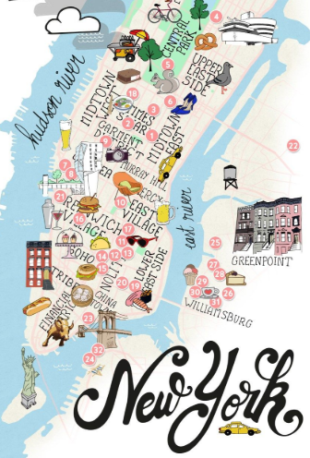
Know-b4-u-go
ERIC LIEU
MJ VILLACRESES
FRANCIS IMPERIAL
AMANDA WISHNIE
Notes:
How many of you have rented an Airbnb?
Who did research on the cities they were visiting prior to making a decision?
I’m assuming you has had to click through multiple different websites to find everything you wanted to know…

Slide 2
How are we going to help you?
WHITESPACE OPPORTUNITY Application that provides all the data you need to plan your next trip
FEATURES Airbnb pricing history Crime Data overview Where to eat & drink Insights Analysis
MOTIVATIONS:
SIMPLIFYING THE DECISION MAKING PROCESS WHEN PLANNING A TRIP
WHERE:
AIRBNB OPEN SOURCE
ZOMATO
VADER PYTHON PACKAGE
HOW:
PYTHON
HTML/CSS
JAVASCRIPT
API’s
MACHINE LEARNING
Notes:
That’s where we come! We are filling a white-space in the market that’s a one stop shop to get a holistic perspective of where you’ll be staying
KNOW B4 U GO!
We currently have 4 main features rolled out on our beta site and for our test are only focusing on New York City
Airbnb pricing history from 2018 by neighborhood
NYPD crime data from 2018
What bars and restaurants there are by neighborhood / rating
Insights Analysis overviewing Airbnb comments from 2018

Slide 3
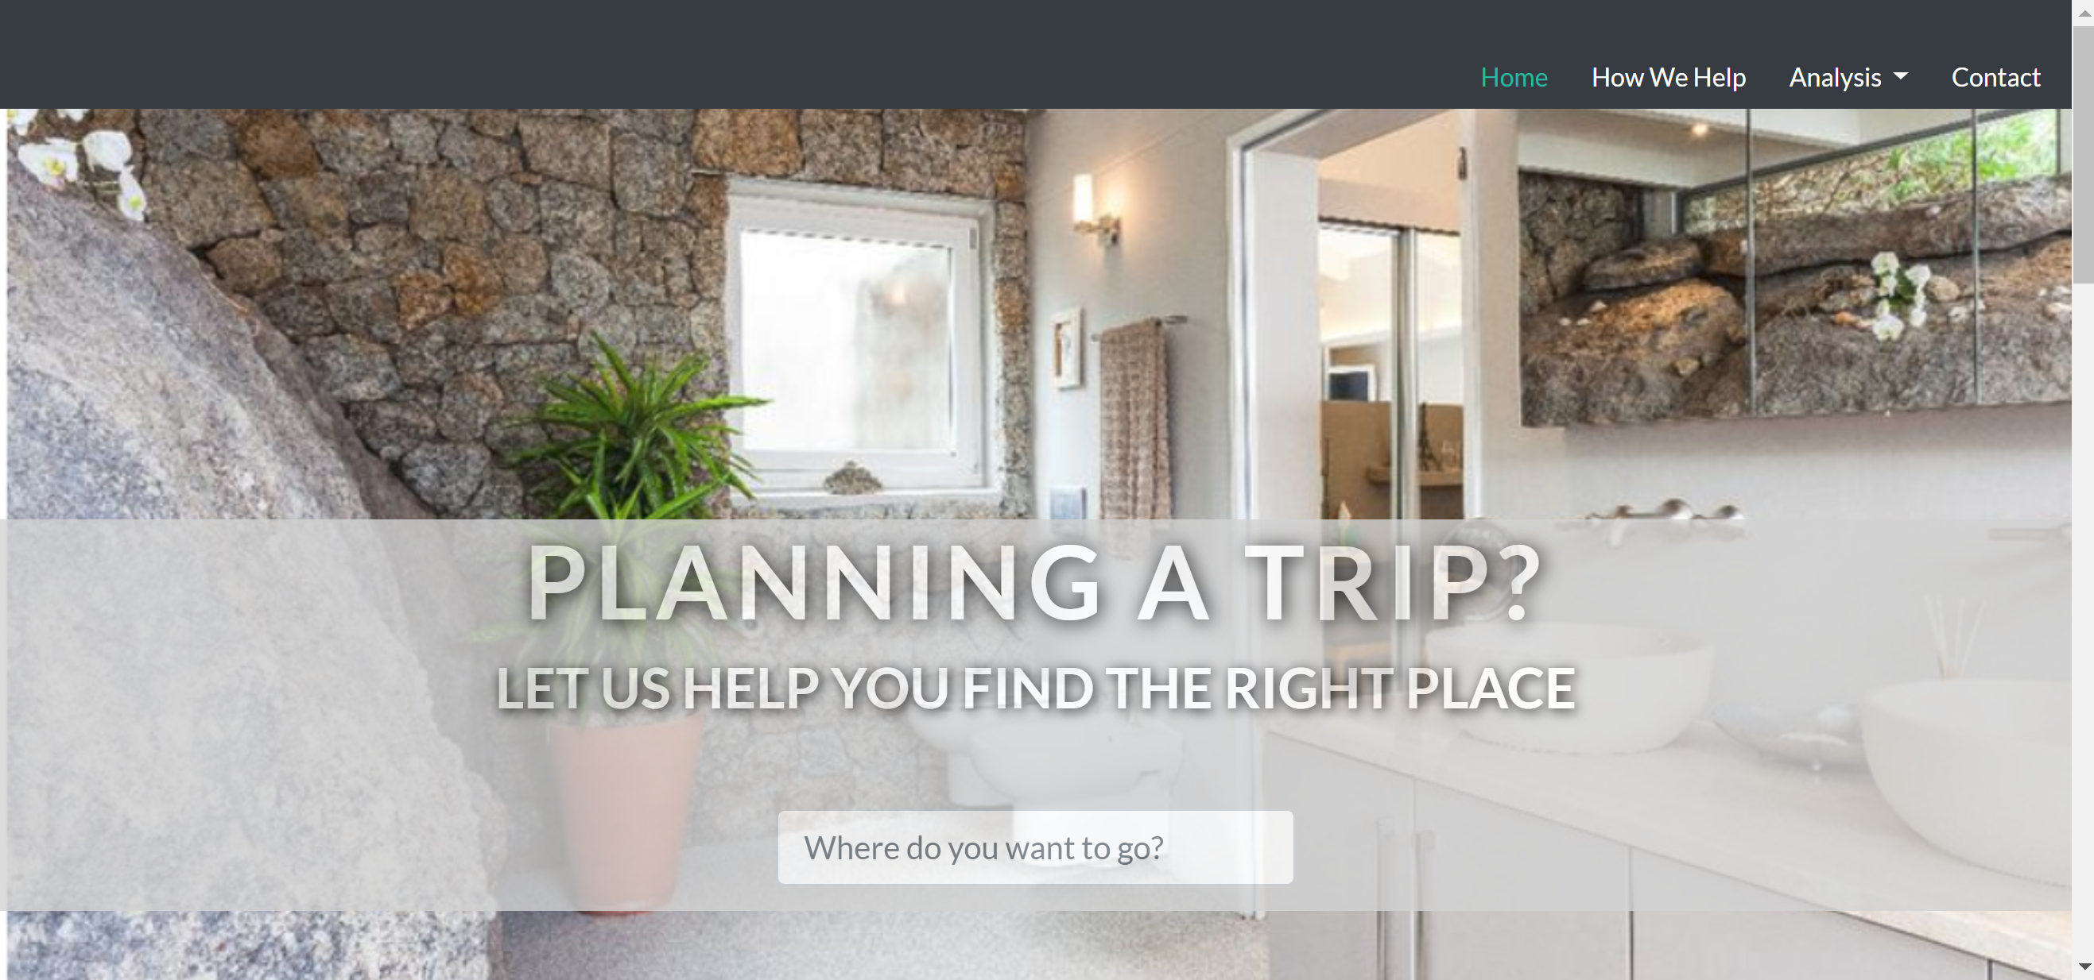
WHAT DID WE DO?
Notes:
We built a website with HTML/CSS to display our findings and provide an interactive UI/UX for our users
This is currently only a web-based application but will eventually launch as an app.
I am now going to pass it over to Francis so he can take you through our amazing features

Slide 4
DATA CLEANSING & interactive MAP

Slide 5












AIRBNB Price MAP DEVELOPMENT
Airbnb and Neighborhood Data Collection
Jupyter Notebook
Leaflet GeoMapping
Notes:
Collected csv files from Inside Airbnb for listings from the year 2018 and a GeoJson file from data.BetaNYC to collect information on the polygons of each neighborhood in NYC
This was probably the most tricky part of the process because I had a plethora of data that was all unorganized and separated, but I had one goal in mind and that was to create a GeoJson file
I first uploaded each month of data from 2018 and filtered each month to 7 columns down from the original 96 and then appended each month to create a full years worth of almost 300,000 rows of data
Then I grouped the data by neighborhood and found the median price of each and input that into its own data frame
Then I iterated through my median price data frame and appended the median price to the properties section of the GeoJson file by first converting it into its own data frame and later exporting it to a CSV file
Then my life savior csvjson.com came into play and I converted the CSV file with the newly appended prices back into a Json file and copied that data and created a data.js file to reference to for my Leaflet map
Finally, based on a previous example we went over in class, I created a Leaflet.js map with color coded NYC neighborhoods with respect to their price and labeled specific price ranges on a red-green color scale (with red being most expensive and green being least)

Slide 6
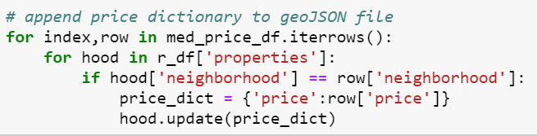
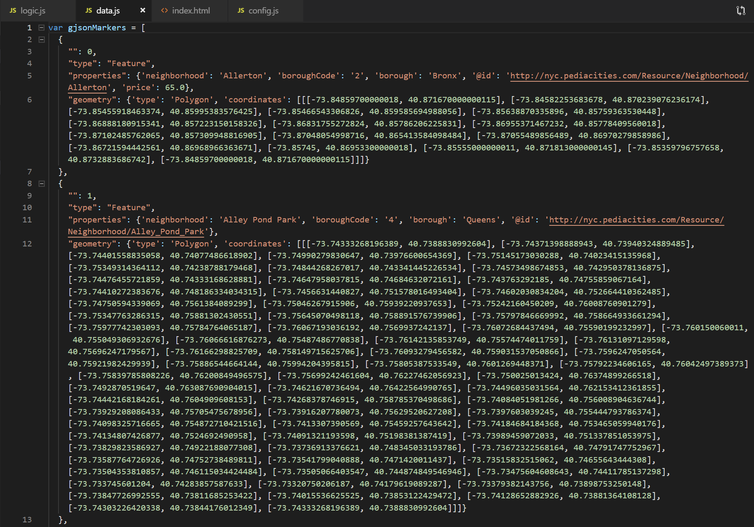
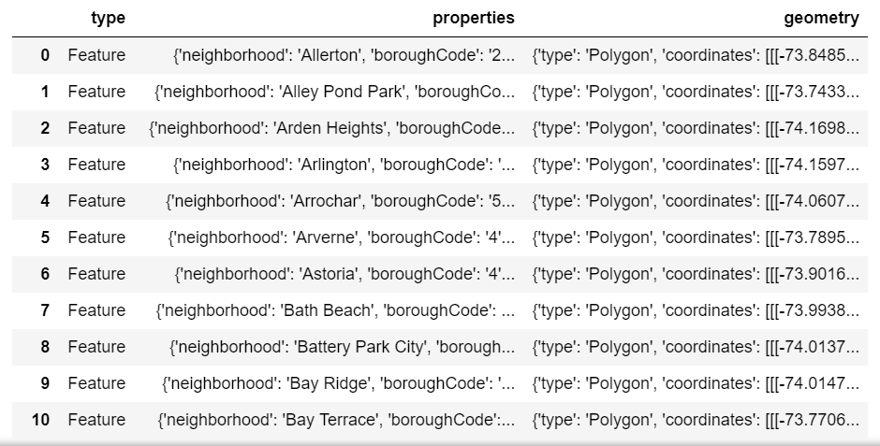
Data Cleansing

Slide 7

crime MAP DEVELOPMENT
NYPD YTD Complaint Data
Jupyter Notebook
Leaflet GeoMapping
Notes:
Downloaded NYPD Complaint Data Year-to-Date from NYC OpenData ins CSV format
Using python in Jupyter Notebook and pandas dataframe, filtered for relevant columns (e.g. offense description, precinct, borough, violation type, and most importantly the latitude and longitude coordinates) to create a cleaned up CSV file for 2018 crime data with relevant data
Created child CSV files by violation type (e.g. assault, larceny, drug-related, etc.)
Using python and pandas, each CSV file was converted into a list of dictionaries before finally being converted into json files
Based on our Geo-mapping homework, I created a map that would plot all the crime reports by type and color onto the NYC map
Then, combined it with Francis’ neighboorhood pricing map by overlaying it with various crime layers
Search function was also included using a leaflet control search plugin – leveraging Francis’s already made GeoJson data, I re-used the same neighborhood data to create search and zoom by neighborhood

Slide 8
INSIGHTS ANALYSIS & GENDER BIAS

Slide 9
WHATS NEXT?

Slide 10
KNOW-B4-U-GO FUTURE IMPLEMENTATIONS
GLOBAL EXPANSION:
ADD ALL GLOBAL MAJOR CITIES TO THE SITE
EVENTUALLY ADD SMALLER CITIES THAT ARE TRYING TO INCREASE TOURISM
Apt Owner
&
Renter
Global Expansion
Search Function
&
Homepages
Airbnb Price Predictor & Scale
Suggestions
Feature
SEARCH FUCNTION & HOMEPAGES:
HOMEPAGE FORM BUTTON THAT ALLOWS YOU TO SEARCH FOR THE CITY YOU WANT TO LEARN MORE ABOUT
CREATE HOMEPAGES FOR EACH CITY WE FEATURE ON THE SITE
PRICE PREDICTOR & SCALE:
WITH MACHINE LEARNING, DEVELOP AN AIRBNB PRICE PREDICTOR THAT LEVERAGES HISTORICAL DATA BY NEIGHBORHOOD OR CITY
GOAL OF THIS IS TO HELP APT OWNERS UNDERSTAND THE CURRENT AND FUTURE PRICING ENVIORNMENT
SUGGESTIONS FEATURE:
MAKE SUGGESTIONS ON WHERE TO TRAVEL BASED ON DIFFERENT USER INPUT CONDITIONS
RELAXING VACATION WITH LITTLE CRIME?
BUDGETED TRIP? TRAVEL BASED ON AIRBNB PRICING
PARTY ANIMAL? STAY WHERE THE BARS ARE

